Slide 1

E-COMMERCE SALES ANALYTICS USING DATA VISUALIZATION
"The objective of this project is to analyze and visualize e-commerce sales data to identify key trends, patterns, and insights. We aim to provide actionable recommendations to improve sales performance and enhance decision-making for the e-commerce business."

Slide 2

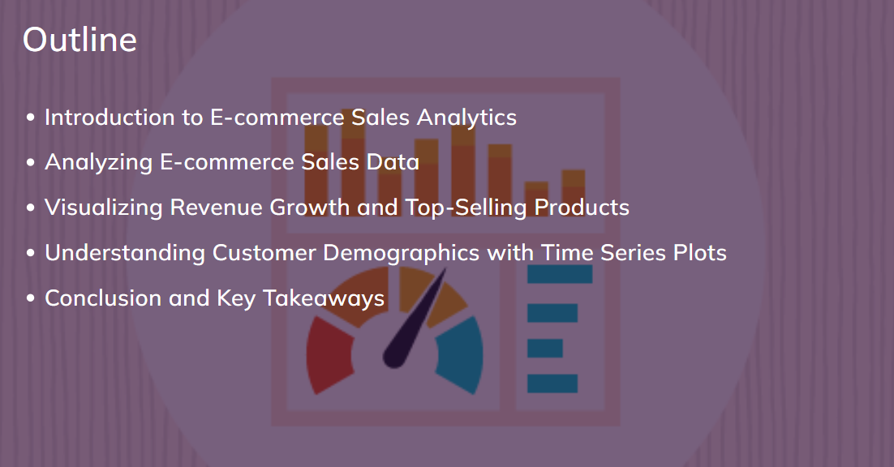
CONTENTS OF THIS TEMPLATE
Here’s what you’ll find in this Slidesgo template:
A slide structure based on a business plan, which you can easily adapt to your needs. For more info on how to edit the template, please visit Slidesgo School or read our FAQs.
An assortment of illustrations that are suitable for use in the presentation can be found in the alternative resources slide.
A thanks slide, which you must keep so that proper credits for our design are given.
A resources slide, where you’ll find links to all the elements used in the template.
Instructions for use.
Final slides with:
The fonts and colors used in the template.
A selection of illustrations. You can also customize and animate them as you wish with the online editor. Visit Stories by Freepik to find more.
More infographic resources, whose size and color can be edited.
Sets of customizable icons of the following themes: general, business, avatar, creative process, education, help & support, medical, nature, performing arts, SEO & marketing, and teamwork.
You can delete this slide when you’re done editing the presentation.

Slide 3

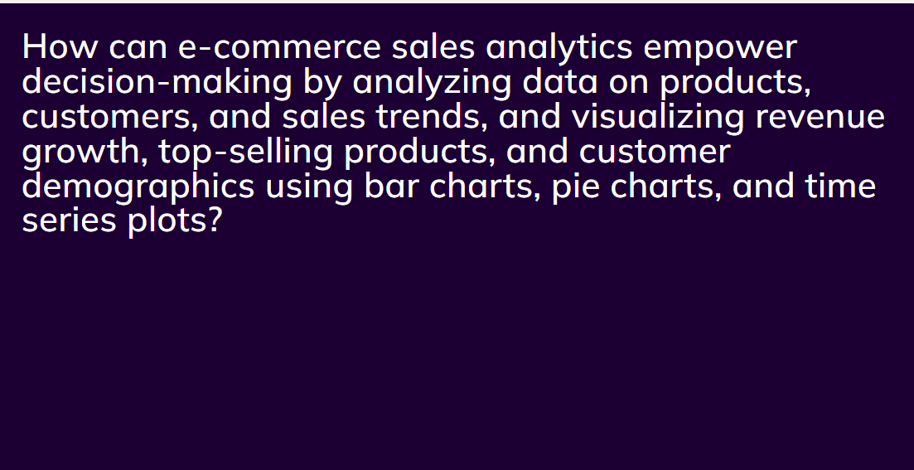
TABLE OF CONTENTS
01
02
03
04
05
06
Business Overview
Market Analysis
Sales and Marketing Plan
Here you could describe the topic of the section
Here you could describe the topic of the section
Here you could describe the topic of the section
Management Plan
Operating Plan
Financial Plan
Here you could describe the topic of the section
Here you could describe the topic of the section
Here you could describe the topic of the section

Slide 4
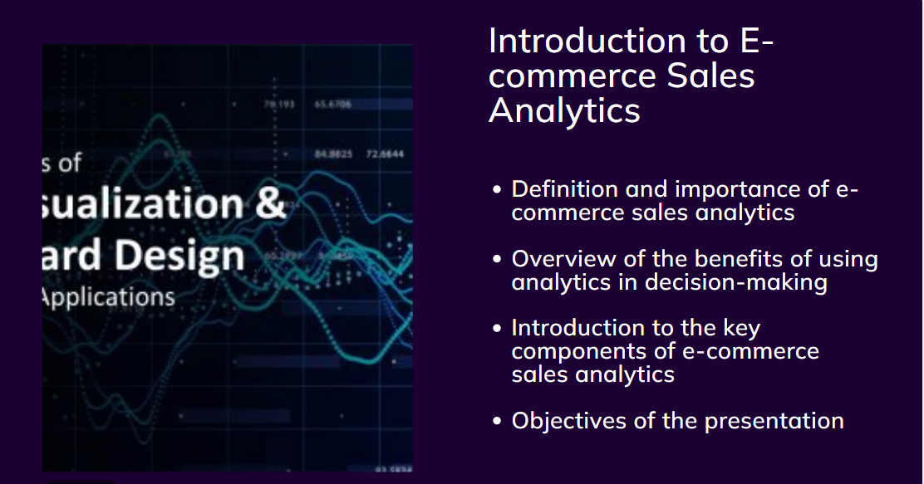
“This is a quote, words full of wisdom that someone important said and can make the reader get inspired.”
—SOMEONE FAMOUS

Slide 5

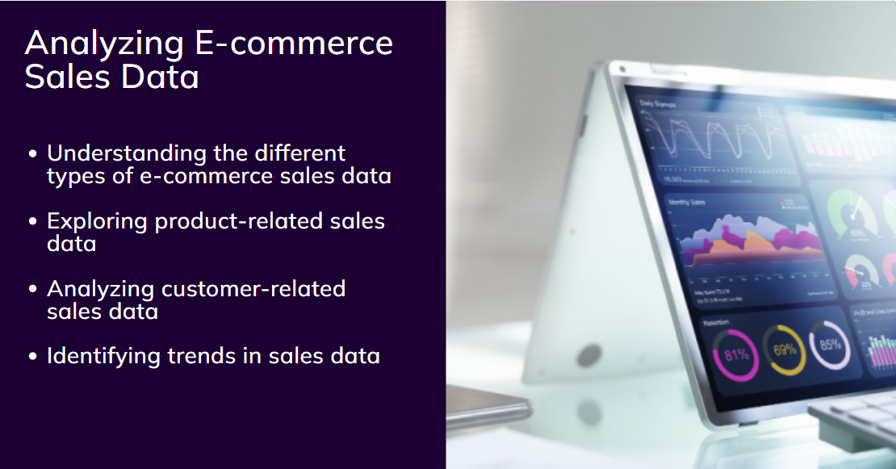

MISSION STATEMENT
Here you could describe the company’s mission. A clear message is a good way to get down to business

Slide 6

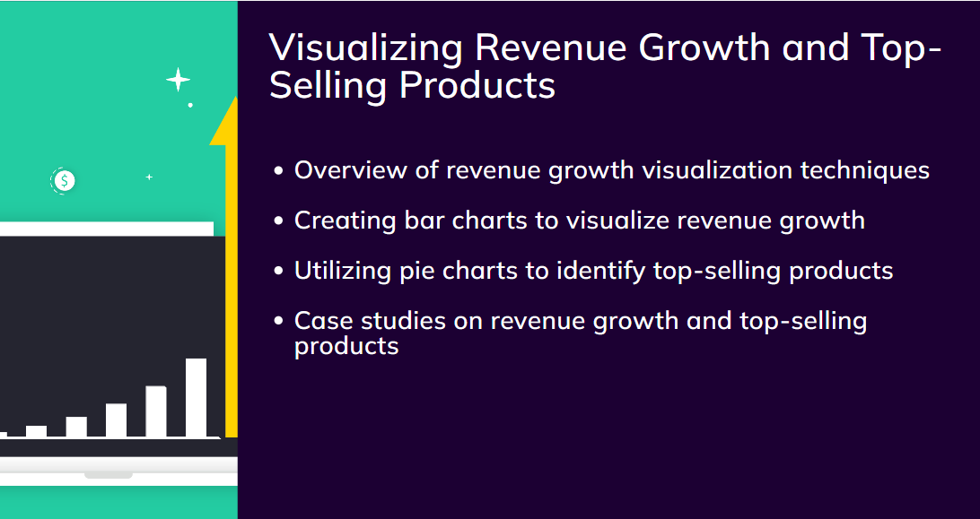

OUR COMPANY
Mercury is the closest planet to the Sun and the smallest one in the Solar System—it’s only a bit larger than the Moon

Slide 7
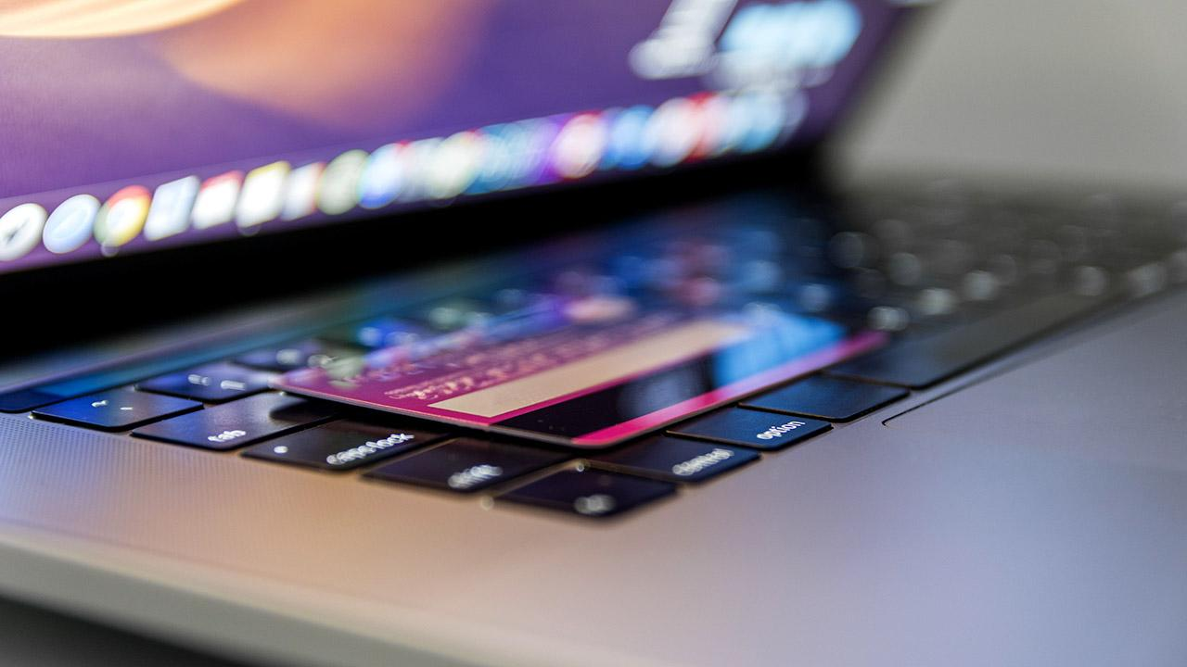
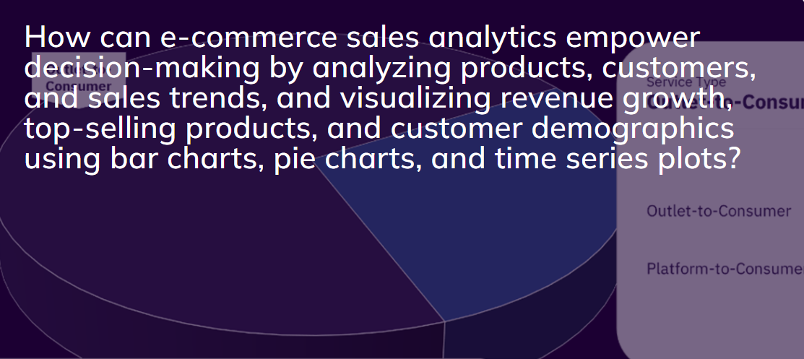
A picture is worth a thousand words

Slide 8
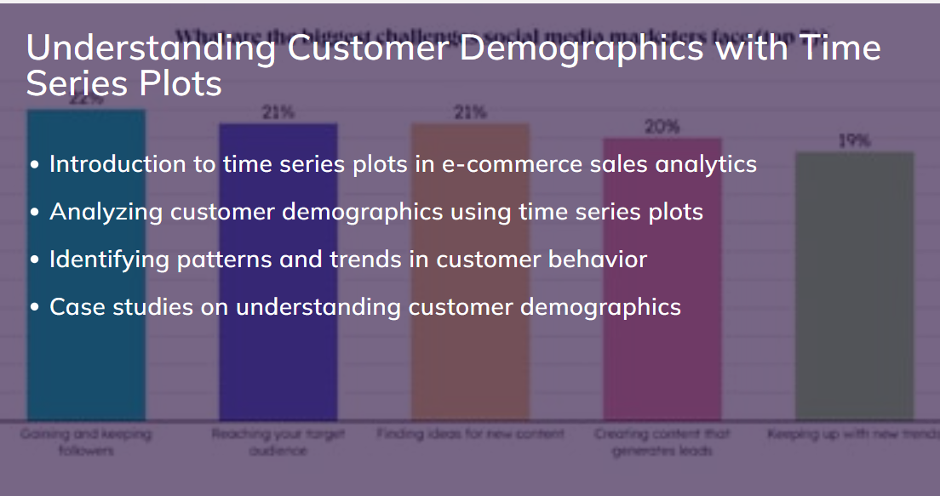
REVIEWING CONCEPTS IS A GOOD IDEA
MERCURY
MARS
Mercury is the closest planet to the Sun
Despite being red, Mars is a cold place
VENUS
SATURN
Venus has a
beautiful name
Saturn is the ringed one and a gas giant
JUPITER
NEPTUNE
It’s the biggest planet in our Solar System
It’s the farthest planet from the Sun

